Slide 1

Intro to MATLAB
Created by Mohammad Zahid, Renee Brady
Adapted by Jeffrey West

Slide 2
Outline
Desktop Basics
Vectors, matrices, structures, and cells
Handling & saving data
.mat files
.csv files
Plotting
2D, 3D plots
Formatting
Saving
Programming
Scripts and functions
Loops and Conditional statements
ODE example

Slide 3
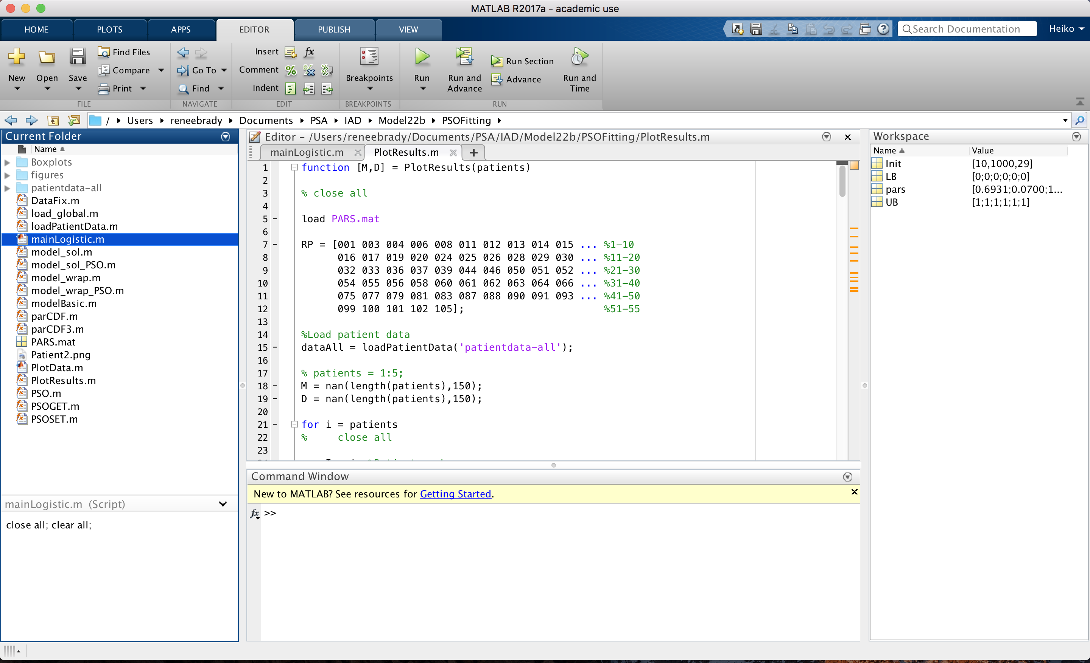
Desktop Basics

Slide 4
Desktop Basics
Current directory

Slide 5
Desktop Basics
Editor

Slide 6
Desktop Basics
Current folder

Slide 7
Desktop Basics
Command Window

Slide 8
Desktop Basics
Workspace

Slide 9
Vectors, Matrices, Structures, & Cells

Slide 10
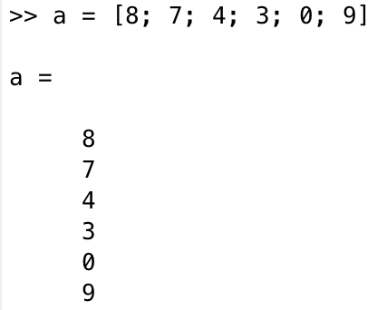
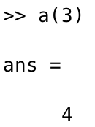
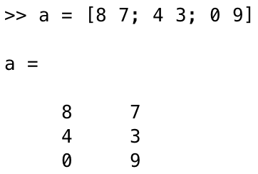
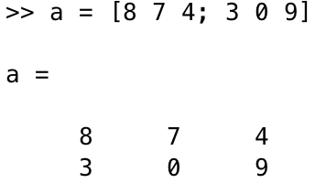
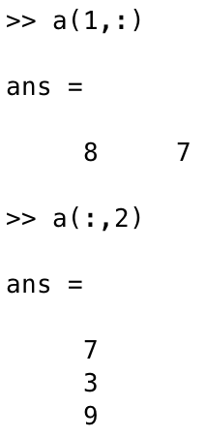
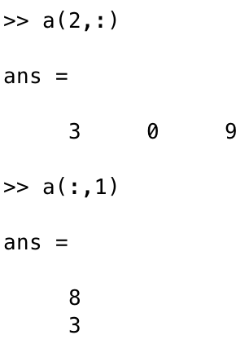
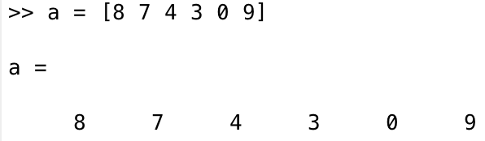
Vectors & Matrices
VECTORS
MATRICES
One dimensional arrays
n-dimensional arrays
Must be same length!
Must be same length!
c
d
c
d
c(1,:)
c(:,2)
d(2,:)
d(:,1)
b
b
Notes:
MATrix LABoratory
All data in MATLAB are mutlidimensional arrays
Linspace

Slide 11
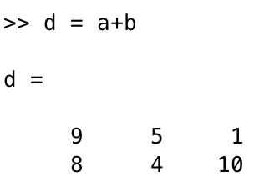
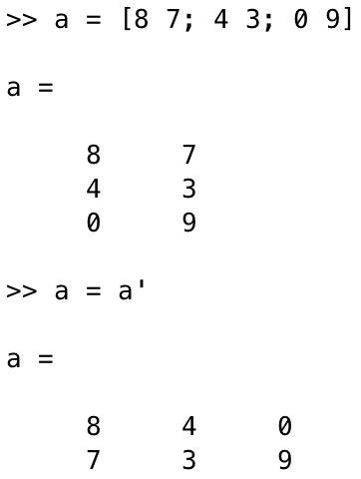
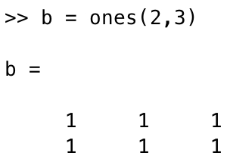

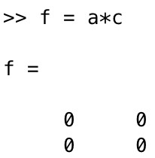

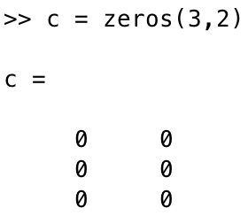
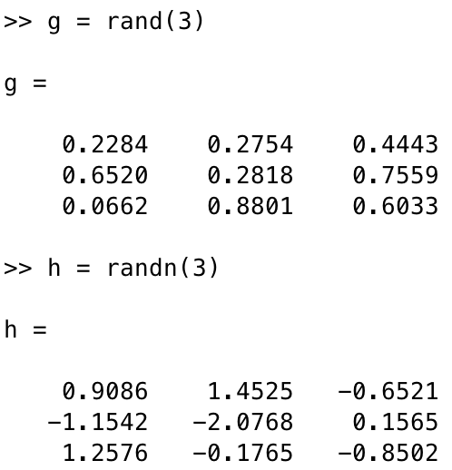
Vectors & Matrices
c
f
h
c
f
h
j
Transpose!
g
k
c
c
g
k
c
m
m
Notes:
repmat(A,M,N)

Slide 12
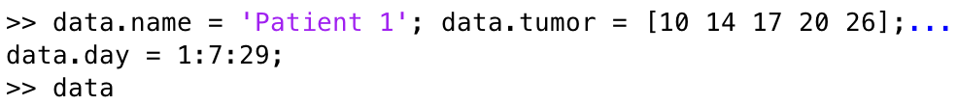
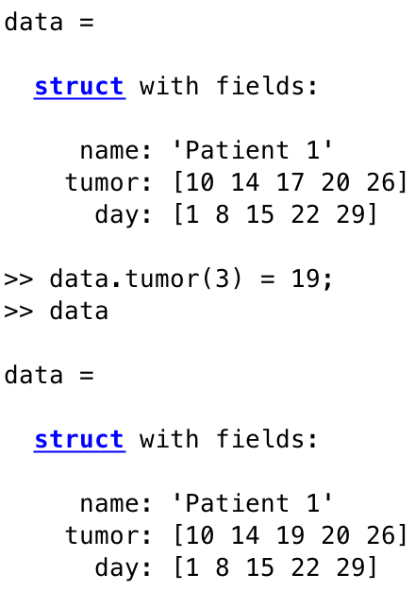
Structure Arrays
Groups related data using containers called fields (each field can contain data of any type or size)
Semicolon suppresses output
Changes 3rd element of tumor field
Continues input on next line
Character data type

Slide 13
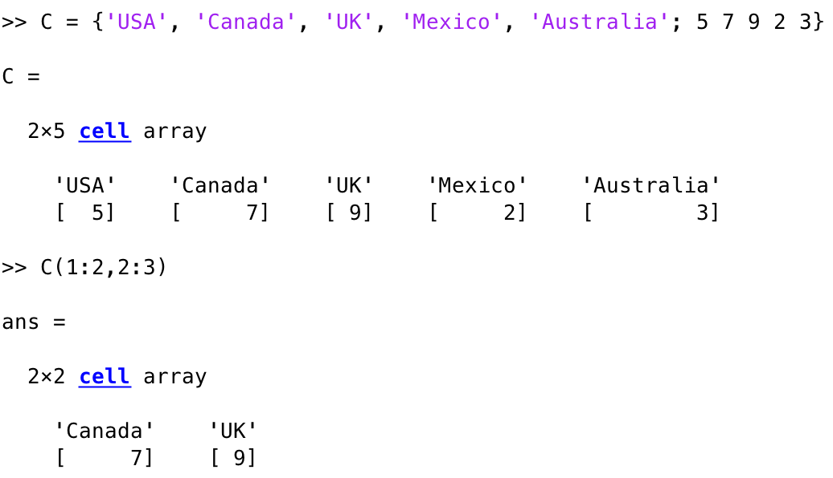
Cell Arrays
Array of indexed cells where each cell can store an array of different dimensions and data types

Slide 14
Handling & saving data

Slide 15
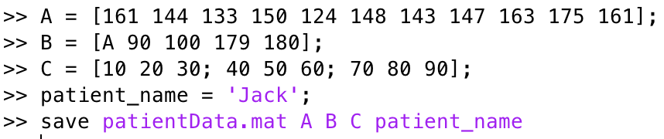


.mat files
.mat files can be used to save data or variables
.mat file will be saved into current folder
Include specific variable names if additional variables are in workspace. If omitted, all variables will be saved into .mat file
Loads all variables in patientData.mat into the workspace
Clears all variables from the workspace
Loads A only in patientData.mat into the workspace

Slide 16
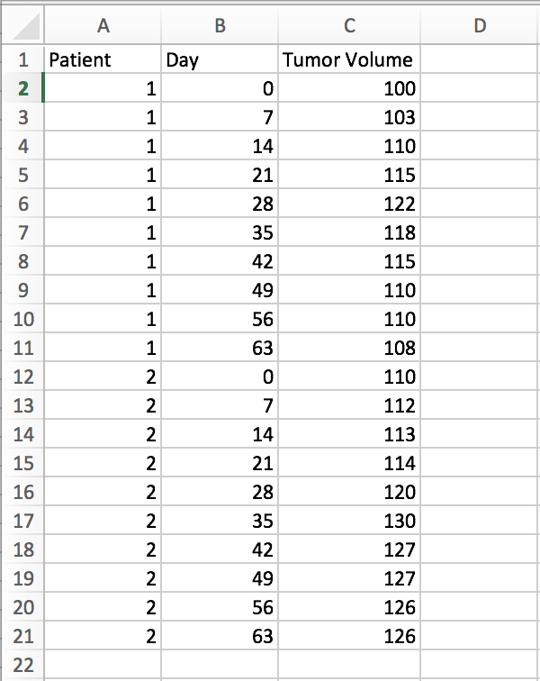
.csv files
Data can be imported from .csv files (comma-separated values)
Reads contents of Example1.csv and saves them into the data variable
Starts reading 1 row below the 1st row

Slide 17
Plotting

Slide 18
2D Line Plot
plot(X,Y)- creates 2D line plot of data in Y versus the corresponding data in X
scatter(x,y)- creates scatter plot with circles at the locations specified in x and y
semilogx(Y) (semilogy(Y))- creates a plot with base 10 log scale for the x-axis (y-axis) and a linear scale for the y-axis (x-axis)
Holds current figure
figure(1); hold on
plot(x,y,'g--','linewidth',6)
xlabel('days')
ylabel('tumor volume')
title('Tumor Volume')
Plots y vs. x with green (g), dashed (--) line, 6 units thick
Axis labels and figure title

Slide 19
3D Line Plot
plot3(X1,Y1,Z1,...)- plots one or more lines in 3D through the points whose coordinates are the elements of X1, Y1, and Z1
scatter3(X,Y,Z)- displays circles at the locations specified by the vectors X, Y, and Z
figure(2); hold on
scatter3(x,y,z,200,'filled','b')
xlabel('days')
ylabel('PSA')
zlabel('testosterone')
Scatter plot x,y, and z with blue (b) filled circles of size 200

Slide 20
Programming

Slide 21
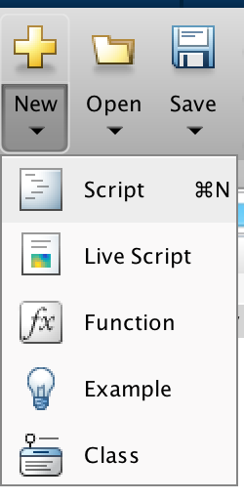
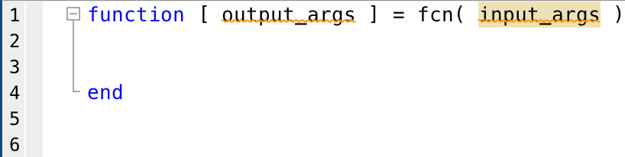
Scripts & functions
MATLAB does not enable you to save work from the command window
To bypass that, work can be saved in scripts and functions to be used at a later time
Scripts have no input or output arguments
Useful for automating computations that you have to perform repeatedly from the command line or series of commands you have to reference
Each time you run it, the script stores the variables in the workspace
Functions can have both input and output arguments
They have their own workspace, separate from the base workspace. Therefore, none of the calls to the function overwrite the value of other variables in the base workspace

Slide 22
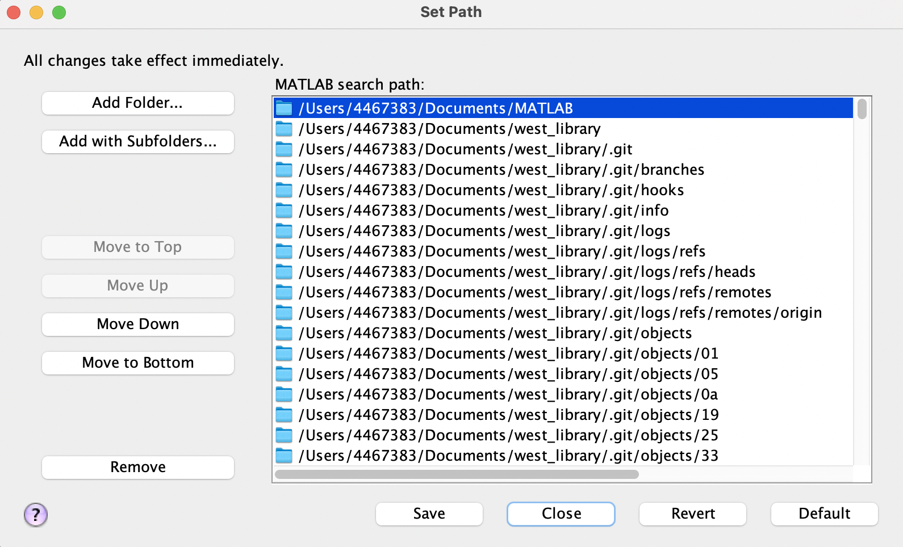
Add common scripts to PATH!
Create a folder of common functions
Common calculations, read/write/save functions, colors, plot tools, etc
Add to path and they will be accessible from any script that you run from Matlab!
HOME -> Set Path -> Add folder

Slide 23
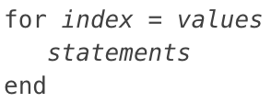
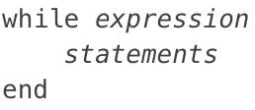
Loops & Conditional Statements
for statements loop a specific number of times and keep track of each iteration with an incrementing index variable
while statements loop as long as a condition remains true

Slide 24
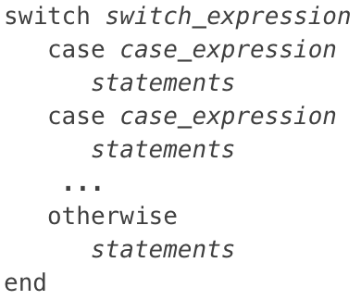
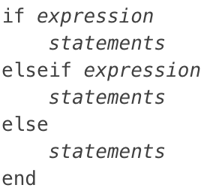
Loops & Conditional Statements
if statements execute the proceeding lines if the statement is true. If the initial statement is false, another command may be executed if the statement following elseif is true
switch statements are used to test equality against a set of known values

Slide 25
ODE Examples

Slide 26
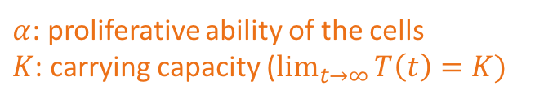

Gompertz Growth
For the Gompertz model, given by
$$\frac{dT}{dt}=α\log\left(\frac{K}{T}\right)T,$$
plot the tumor growth over 20 days, where $α=0.2,$ $K=500,$ and $T\left(0\right)=100.$ How does the growth change when $α=e$? $α=\text{−}0.01$?
$α$: proliferative ability of the cells
$K$: carrying capacity ($\lim_{t→∞}{T\left(t\right)=K})$

Slide 27
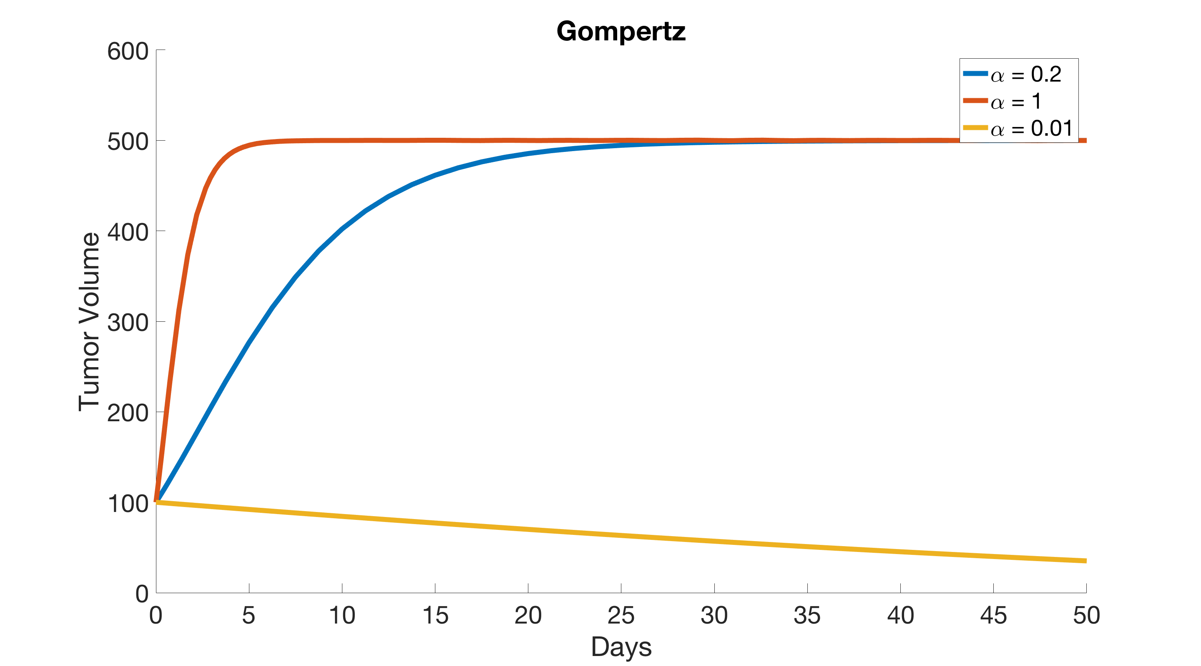

Slide 28
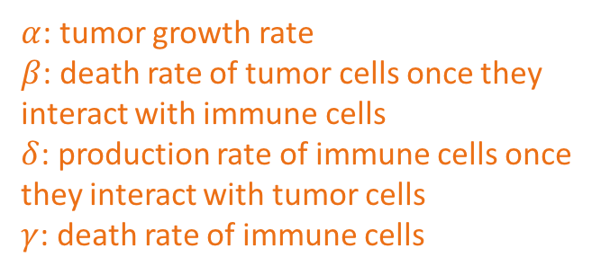
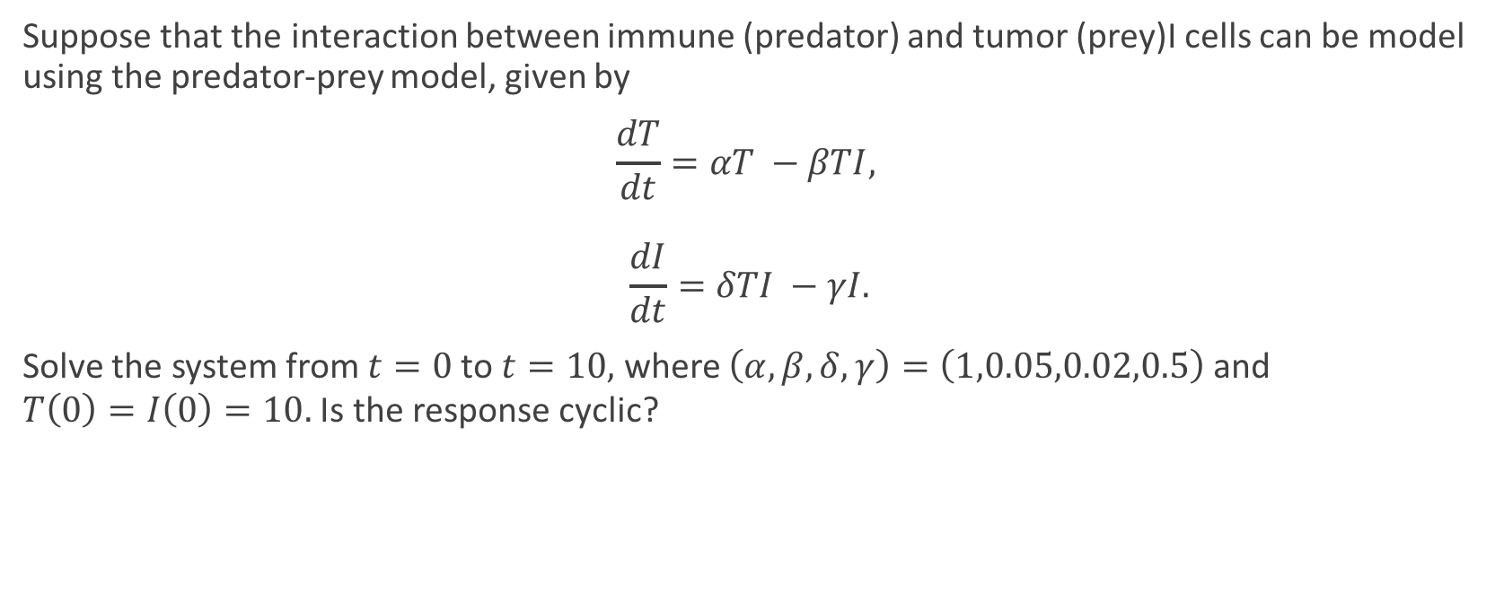
Predator-Prey Model
Suppose that the interaction between immune (predator) and tumor (prey)I cells can be model using the predator-prey model, given by
$$\frac{dT}{dt}=αT −βTI,$$
$$\frac{dI}{dt}=δTI −γI.$$
Solve the system from $t=0$ to $t=10,$ where $\left(α, β, δ, γ\right)=\left(1,0.05,0.02,0.5\right)$ and
$T\left(0\right)=I\left(0\right)=10.$ Is the response cyclic?
$α$: tumor growth rate
$β$: death rate of tumor cells once they interact with immune cells
$δ$: production rate of immune cells once they interact with tumor cells
$γ$: death rate of immune cells

Slide 29
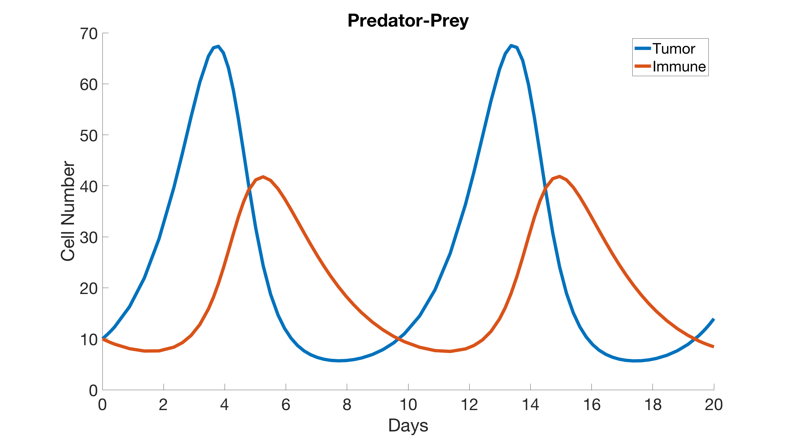

Slide 30
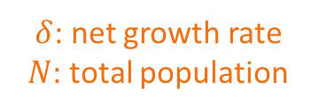
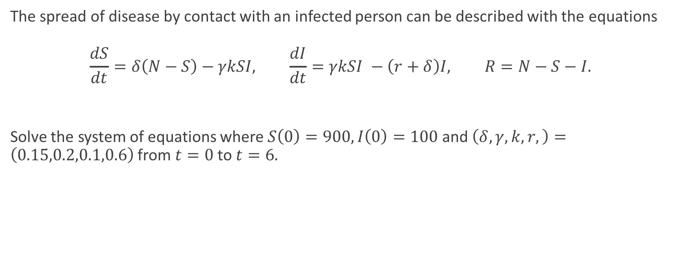

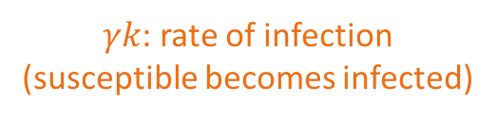
SIR Model
The spread of disease by contact with an infected person can be described with the equations
$$\frac{dS}{dt}=δ\left(N−S\right)−γkSI, \frac{dI}{dt}=γkSI −\left(r+δ\right)I, R=N−S−I.$$
Solve the system of equations where $S\left(0\right)=900, I\left(0\right)=100$ and $\left(δ, γ, k,r,\right)=\left(0.15,0.2,0.1,0.6\right)$ from $t=0$ to $t=6.$
$δ$: net growth rate
$N$: total population
$γk$: rate of infection (susceptible becomes infected)
$r$: rate of recovery

Slide 31
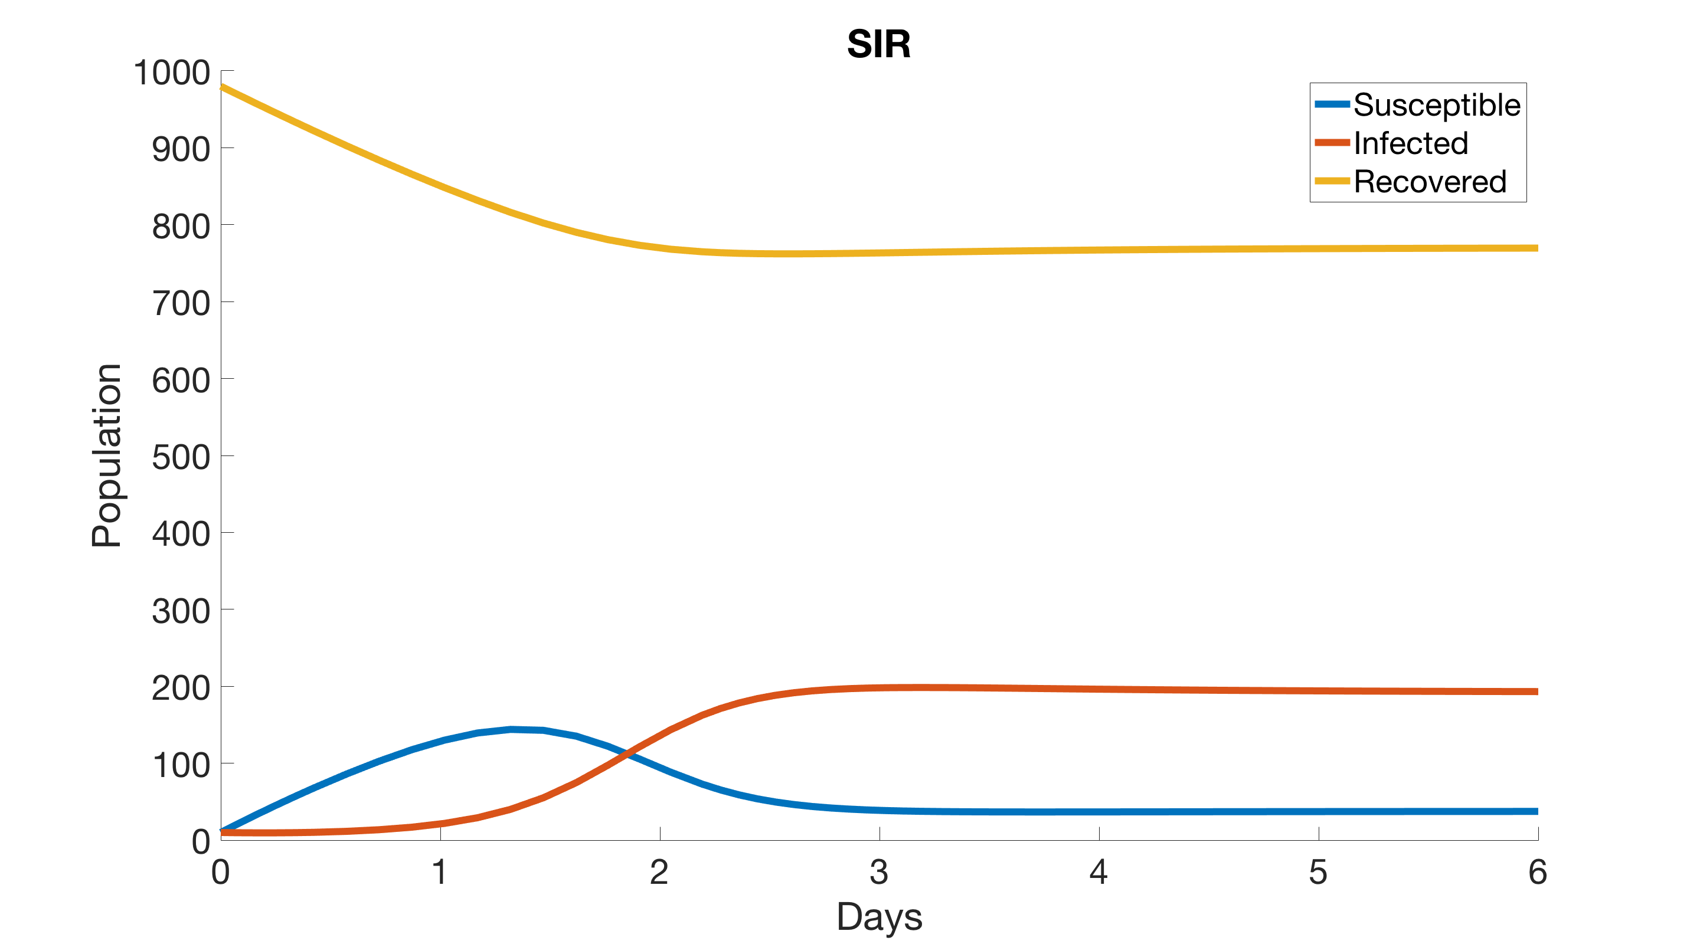

Slide 32
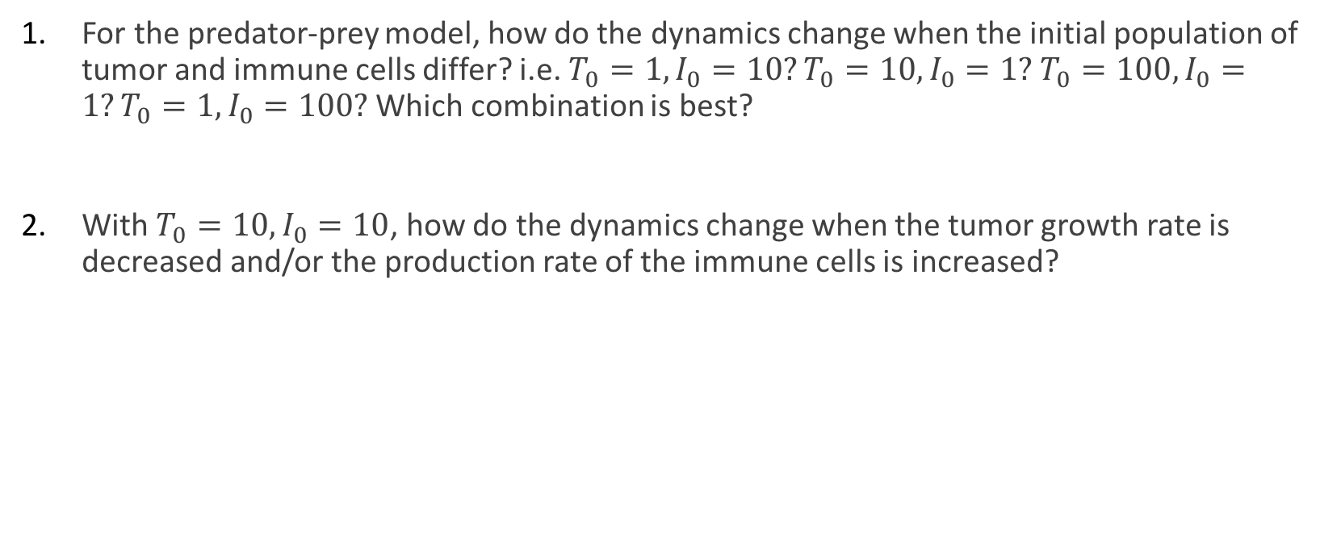
Exercise
For the predator-prey model, how do the dynamics change when the initial population of tumor and immune cells differ? i.e. $T_{0}=1, I_{0}=10?T_{0}=10, I_{0}=1?$ $T_{0}=100, I_{0}=1?T_{0}=1, I_{0}=100?$ Which combination is best?
With $T_{0}=10, I_{0}=10$, how do the dynamics change when the tumor growth rate is decreased and/or the production rate of the immune cells is increased?

